Slide 1

22년 삼성 AI 전문가과정
6월 8일 수요일 5교시
장병탁
인공지능
11차시 : Probabilistic Reasoning
서울대학교 컴퓨터공학부
담당 교수: 장병탁
Seoul National University
Byoung-Tak Zhang

Slide 2
Lecture Overview
인공지능
11차시 : Probabilistic Reasoning
서울대학교 컴퓨터공학부
담당 교수: 장병탁
Seoul National University
Byoung-Tak Zhang

Slide 3
Introduction
Quantifying Uncertainty and Information Theory (Previous lecture)
The right thing to do—the rational decision—depends on both the relative importance of various goals and the likelihood.
Other solutions for estimation of uncertainty: entropy, joint entropy, conditional entropy, mutual information, cross entropy, relative entropy, etc.
Probabilistic Representations of the World (This lecture)
How to represent dependency relationships explicitly in Bayesian networks. Syntax and semantics
How to capture uncertain knowledge in a natural and efficient way
Probabilistic Reasoning (This lecture)
How probabilistic inference can be done efficiently in many practical situations
A variety of approximate inference algorithms (vs. exact inference)

Slide 4
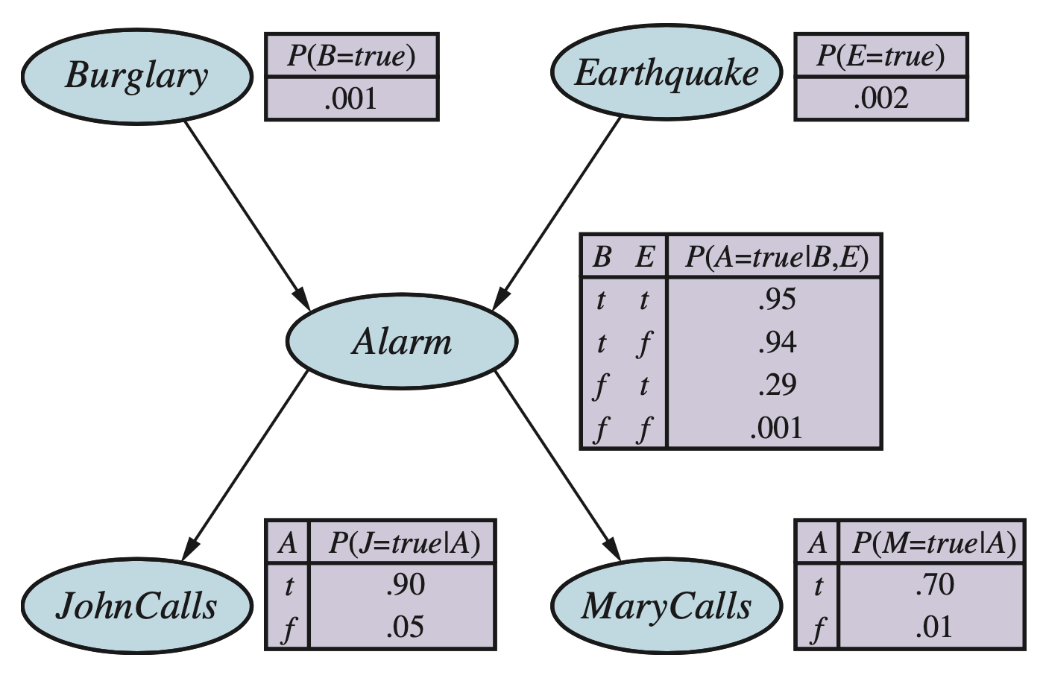
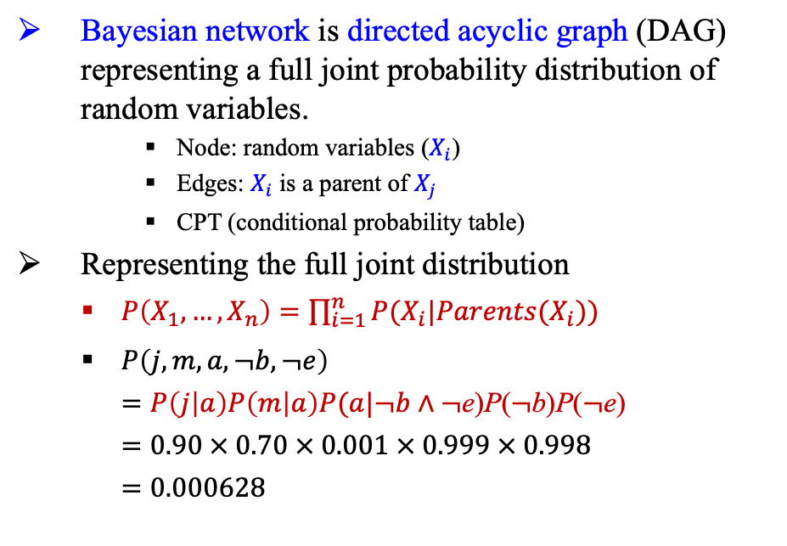
Bayesian Networks
Bayesian network is directed acyclic graph (DAG) representing a full joint probability distribution of random variables.
Node: random variables ($X_{i}$)
Edges: $X_{i}$ is a parent of $X_{j}$
CPT (conditional probability table)
Representing the full joint distribution
$P\left(X_{1},…,X_{n}\right)=\prod_{i=1}^{n}{P(X_{i}|Parents(X_{i}))}$
$P\left(j,m,a,¬b,¬e\right)$ $=P\left(j | a\right)P\left(m | a\right)P(a|¬b∧¬\text{e}\text{)}\text{P}\text{(}¬\text{b}\text{)}\text{P}\text{(}¬\text{e}\text{)}$ $=0.90 × 0.70 × 0.001 × 0.999 × 0.998$ $=0.000628$
<출처> Stuart J. Russell and Peter Norvig (2021). Artificial Intelligence: A Modern Approach (4th Edition). Pearson

Slide 5

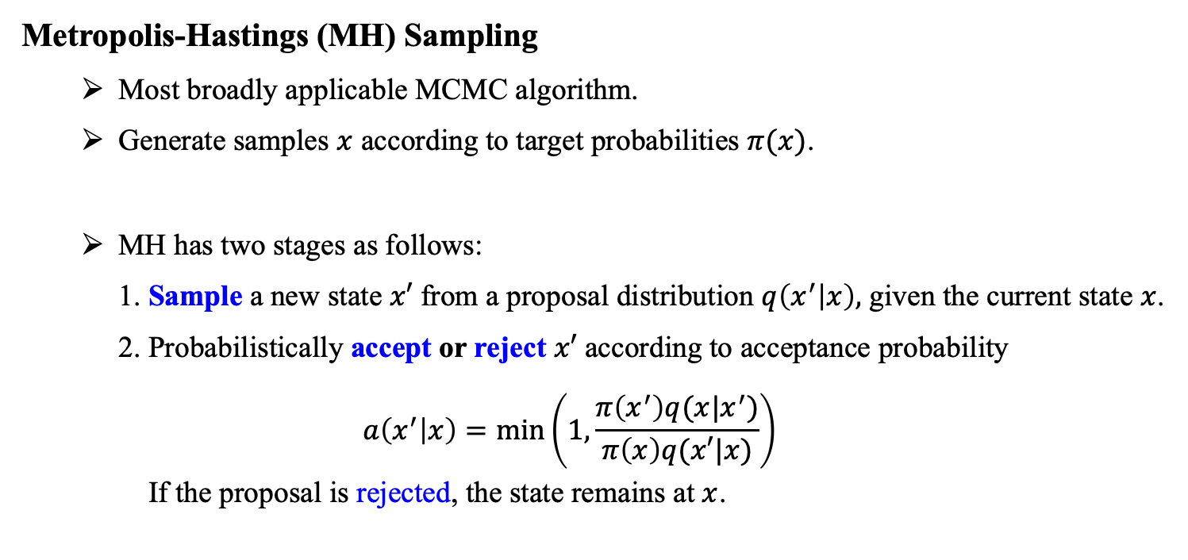
MCMC Sampling for Bayesian Networks
Metropolis-Hastings (MH) Sampling
Most broadly applicable MCMC algorithm.
Generate samples $x$ according to target probabilities $π(x)$.
MH has two stages as follows:
1. Sample a new state $x′$ from a proposal distribution $q\left(x^{′} | x\right),$ given the current state $x$.
2. Probabilistically accept or reject $x′$ according to acceptance probability $$a\left(x^{′} | x\right)=min\left(1,\frac{π\left(x^{′}\right)q(x|x^{′})}{π\left(x\right)q(x′|x)}\right)$$ If the proposal is rejected, the state remains at $x$.

Slide 6
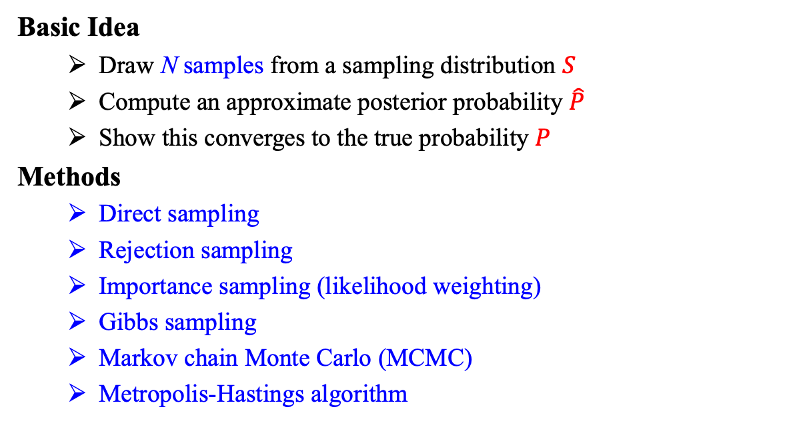
Approximate Inference for Bayesian Networks
Basic Idea
Draw N samples from a sampling distribution $S$
Compute an approximate posterior probability $\hat{P}$
Show this converges to the true probability $P$
Methods
Direct sampling
Rejection sampling
Importance sampling (likelihood weighting)
Gibbs sampling
Markov chain Monte Carlo (MCMC)
Metropolis-Hastings algorithm

Slide 7
Outline (Lecture 11)
11.1 Representing Knowledge in an Uncertain Domain …….
11.2 The Semantics of Bayesian Networks ………………….
11.3 Exact Inference in Bayesian Networks …………......…..
11.4 Approximate Inference for Bayesian Networks …….…..
Summary .….…..………....................….…..………...............
7
10
16
22
33

Slide 8
11.1 Representing Knowledge in
an Uncertain Domain

Slide 9
11.1 Representing Knowledge in an Uncertain Domain (1/2)
Bayesian Network
Represent the dependencies among variables.
Directed graph in which each node is annotated with quantitative probability information.
Details are as follows:
Each node corresponds to a random variable, which may be discrete or continuous.
Directed links or arrows connect pairs of nodes.
Each node has associated probability information that quantifies the effect of the parents of the node using a finite number of parameters.

Slide 10
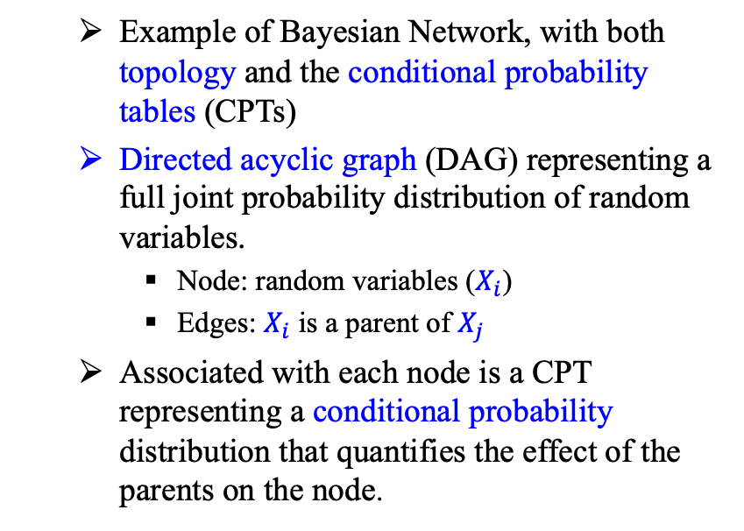
11.1 Representing Knowledge in an Uncertain Domain (2/2)
Example of Bayesian Network, with both topology and the conditional probability tables (CPTs)
Directed acyclic graph (DAG) representing a full joint probability distribution of random variables.
Node: random variables ($X_{i}$)
Edges: $X_{i}$ is a parent of $X_{j}$
Associated with each node is a CPT representing a conditional probability distribution that quantifies the effect of the parents on the node.
<출처> Stuart J. Russell and Peter Norvig (2021). Artificial Intelligence: A Modern Approach (4th Edition). Pearson

Slide 11
11.2 The Semantics of
Bayesian Networks

Slide 12
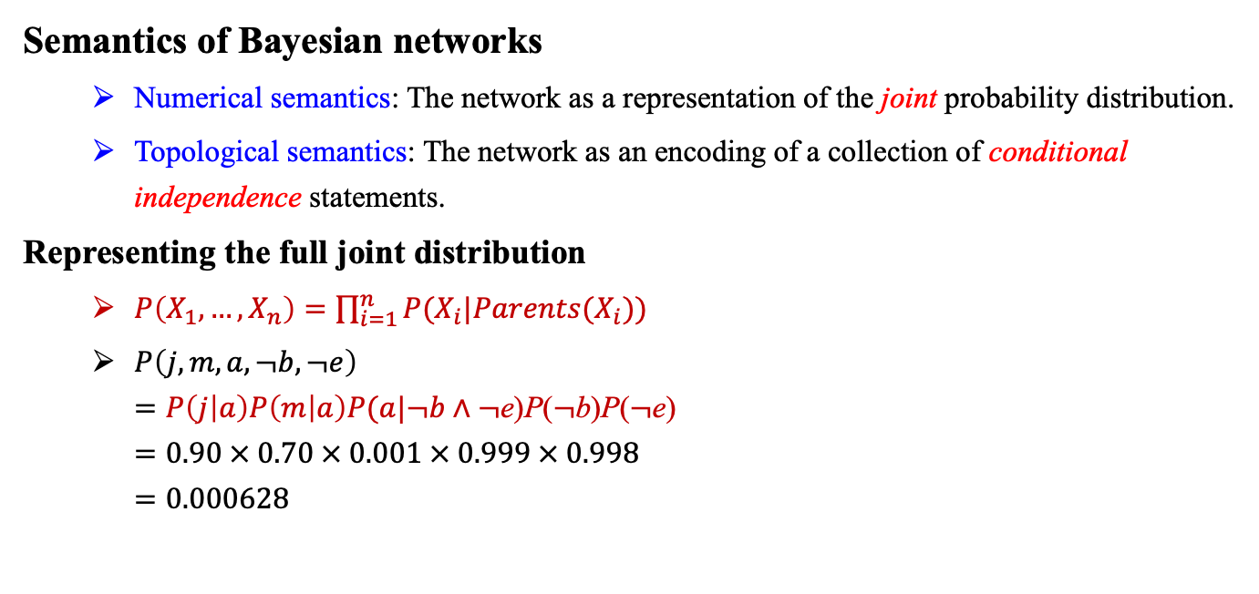
11.2 The Semantics of Bayesian Networks (1/5)
Semantics of Bayesian networks
Numerical semantics: The network as a representation of the joint probability distribution.
Topological semantics: The network as an encoding of a collection of conditional independence statements.
Representing the full joint distribution
$P\left(X_{1},…,X_{n}\right)=\prod_{i=1}^{n}{P(X_{i}|Parents(X_{i}))}$
$P\left(j,m,a,¬b,¬e\right)$ $=P\left(j | a\right)P\left(m | a\right)P(a|¬b∧¬\text{e}\text{)}\text{P}\text{(}¬\text{b}\text{)}\text{P}\text{(}¬\text{e}\text{)}$ $=0.90 × 0.70 × 0.001 × 0.999 × 0.998$ $=0.000628$
<출처> Stuart J. Russell and Peter Norvig (2021). Artificial Intelligence: A Modern Approach (4th Edition). Pearson

Slide 13
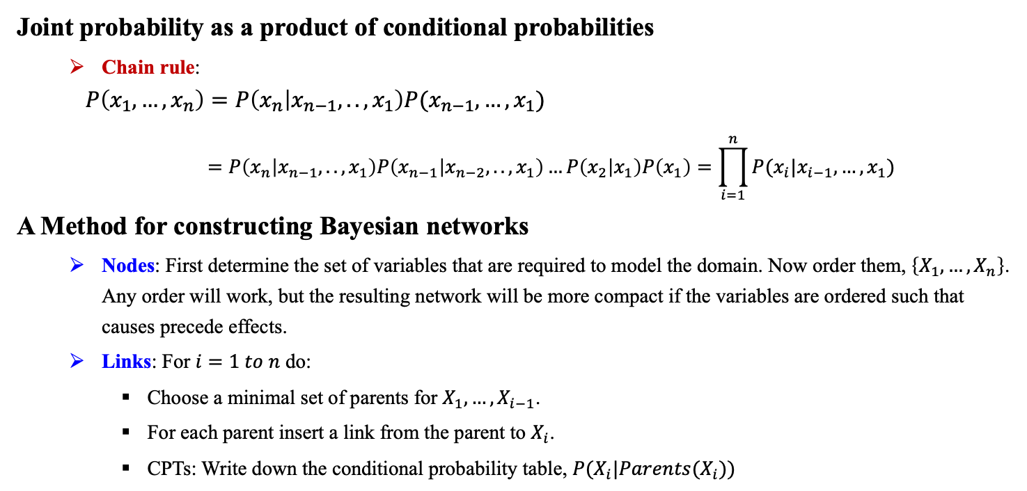
11.2 The Semantics of Bayesian Networks (2/5)
Joint probability as a product of conditional probabilities
Chain rule:
$$P\left(x_{1},…,x_{n}\right)=P\left(x_{n} | x_{n−1},..,x_{1}\right)P(x_{n−1},…,x_{1}) \\ =P\left(x_{n} | x_{n−1},..,x_{1}\right)P\left(x_{n−1} | x_{n−2},..,x_{1}\right)…P\left(x_{2} | x_{1}\right)P\left(x_{1}\right)=\prod_{i=1}^{n}{P(x_{i}|x_{i−1},…,x_{1})}$$
A Method for constructing Bayesian networks
Nodes: First determine the set of variables that are required to model the domain. Now order them, $\left\{X_{1},…,X_{n}\right\}$. Any order will work, but the resulting network will be more compact if the variables are ordered such that causes precede effects.
Links: For $i=1 to n$ do:
Choose a minimal set of parents for $X_{1},…,X_{i−1}$.
For each parent insert a link from the parent to $X_{i}$.
CPTs: Write down the conditional probability table, $P(X_{i}|Parents(X_{i}))$

Slide 14
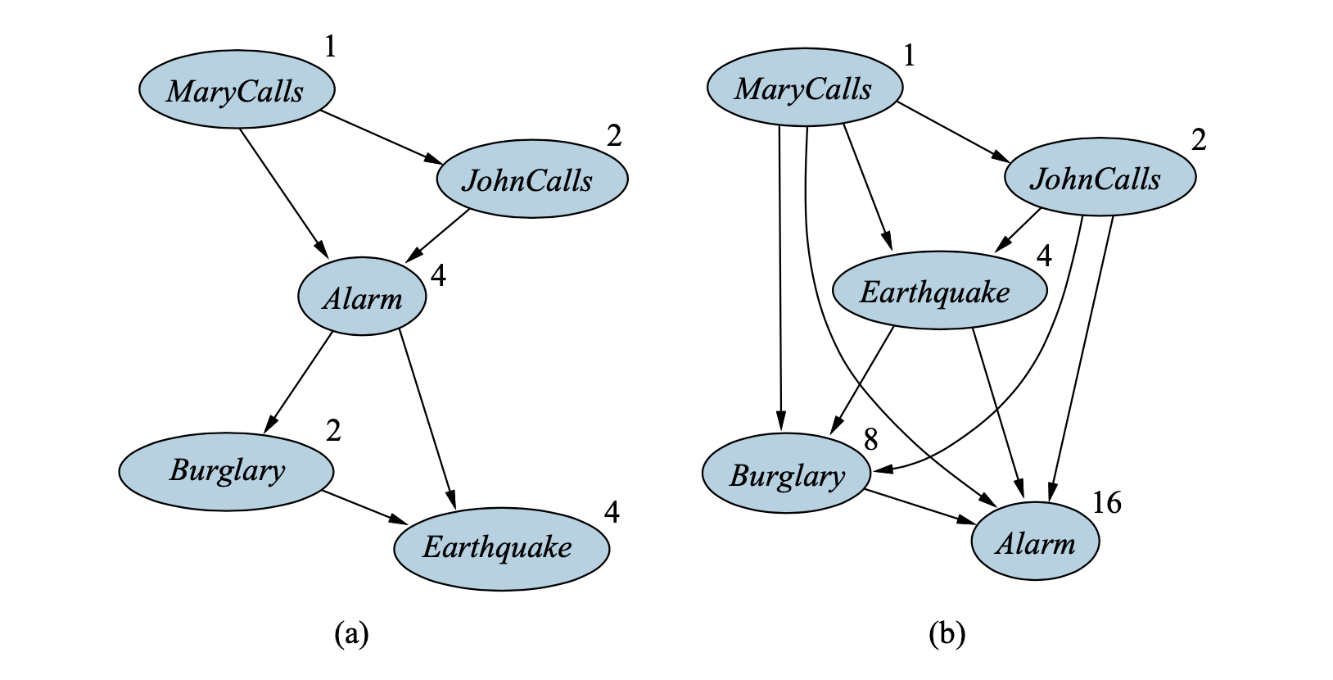
11.2 The Semantics of Bayesian Networks (3/5)
Compactness and node ordering
Ordering 1 (Figure a): <MaryCalls, JohnCalls, Alarm, Burglary, Earthquake>
Ordering 2 (Figure b): <Marycalls, JohnCalls, Earthquake, Burglary, Alarm>
#parameters
required
Total: 13 parameters
Total: 31 parameters
<출처> Stuart J. Russell and Peter Norvig (2021). Artificial Intelligence: A Modern Approach (4th Edition). Pearson

Slide 15
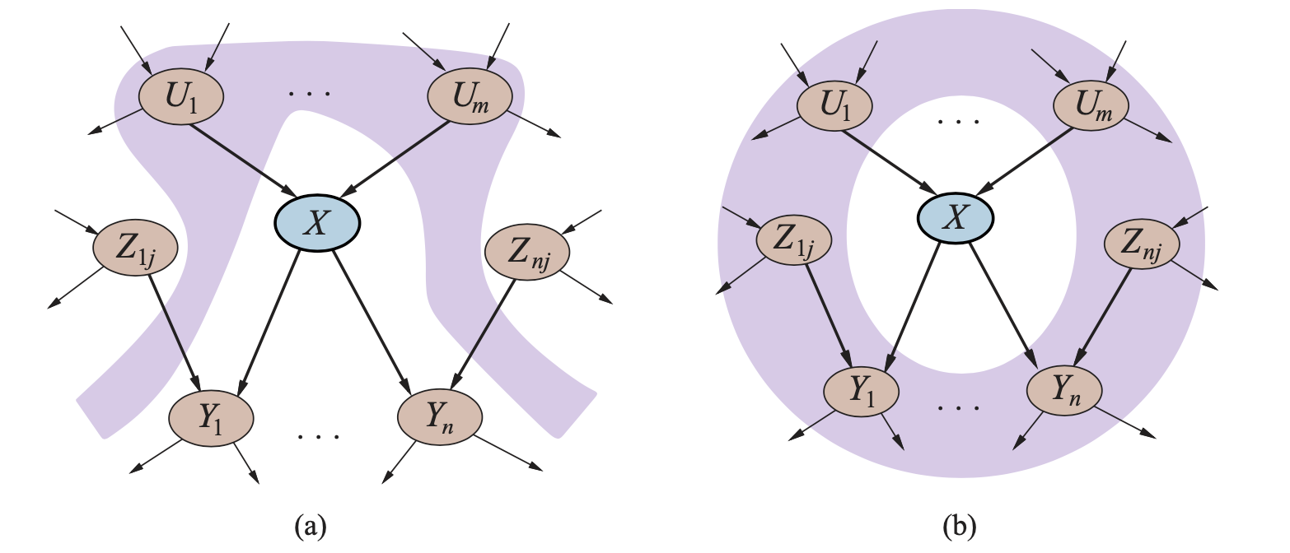
11.2 The Semantics of Bayesian Networks (4/5)
Conditional independence relations in Bayesian networks
Numerical semantics: representation of the full joint distribution (previous)
Topological semantics: conditional independence relationships
Each variable is conditionally independent of its non-descendants, given its parents.
A node is conditionally independent of all other nodes in the network, given its parents, children, and children’s parents, that is, given its Markov blanket.
<출처> Stuart J. Russell and Peter Norvig (2021). Artificial Intelligence: A Modern Approach (4th Edition). Pearson

Slide 16
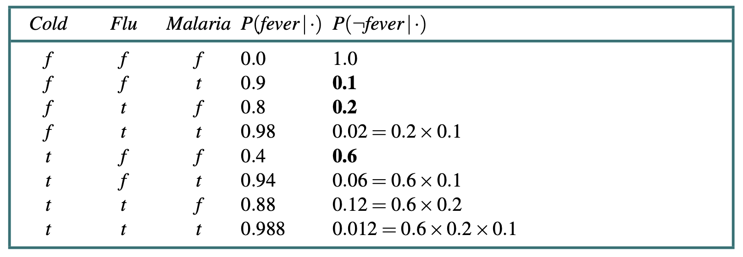
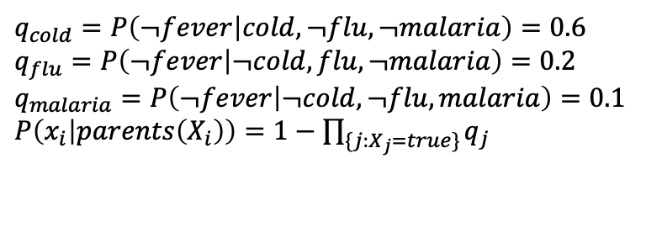
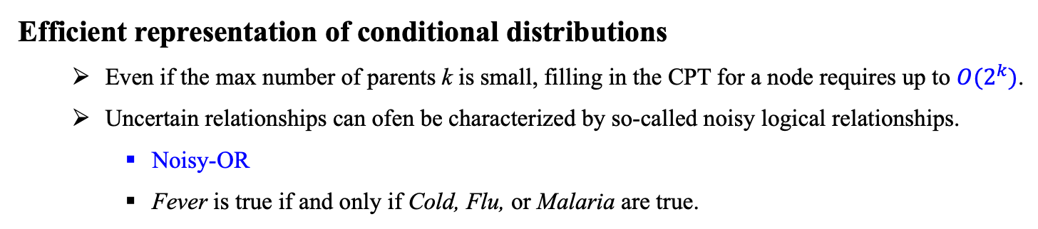
11.2 The Semantics of Bayesian Networks (5/5)
Efficient representation of conditional distributions
Even if the max number of parents k is small, filling in the CPT for a node requires up to $O(2^{k})$.
Uncertain relationships can ofen be characterized by so-called noisy logical relationships.
Noisy-OR
Fever is true if and only if Cold, Flu, or Malaria are true.
Supposed the individual inhibition probabilities are:
$q_{cold}=P\left(¬fever | cold,¬flu,¬malaria\right)=0.6$ $q_{flu}=P\left(¬fever | ¬cold, flu,¬malaria\right)=0.2$
$q_{malaria}=P\left(¬fever | ¬cold,¬flu, malaria\right)=0.1$ $P\left(x_{i} | parents\left(X_{i}\right)\right)=1−\prod_{\{j:X_{j}=true\}}{q_{j}}$
<출처> Stuart J. Russell and Peter Norvig (2021). Artificial Intelligence: A Modern Approach (4th Edition). Pearson

Slide 17
11.3 Exact Inference in
Bayesian Networks

Slide 18
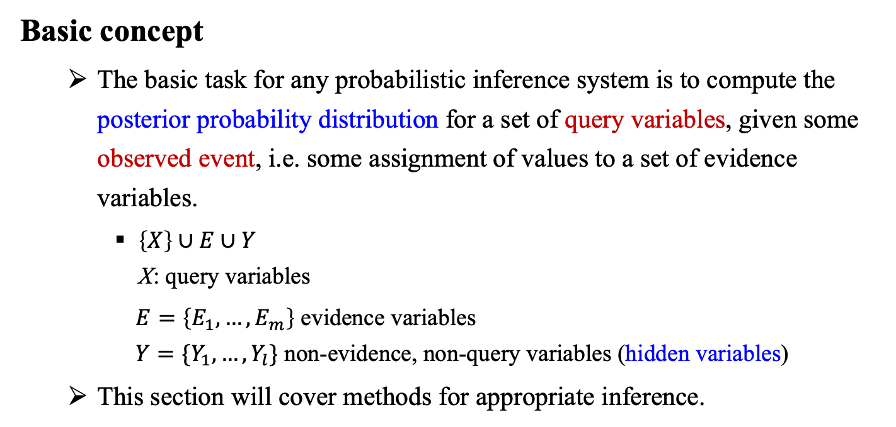
11.3 Exact Inference in Bayesian Networks (1/5)
Basic concept
The basic task for any probabilistic inference system is to compute the posterior probability distribution for a set of query variables, given some observed event, i.e. some assignment of values to a set of evidence variables.
$\left\{X\right\}∪E∪Y$ X: query variables
$E=\left\{E_{1},…,E_{m}\right\}$ evidence variables $Y=\{Y_{1},…,Y_{l}\}$ non-evidence, non-query variables (hidden variables)
This section will cover methods for appropriate inference.

Slide 19
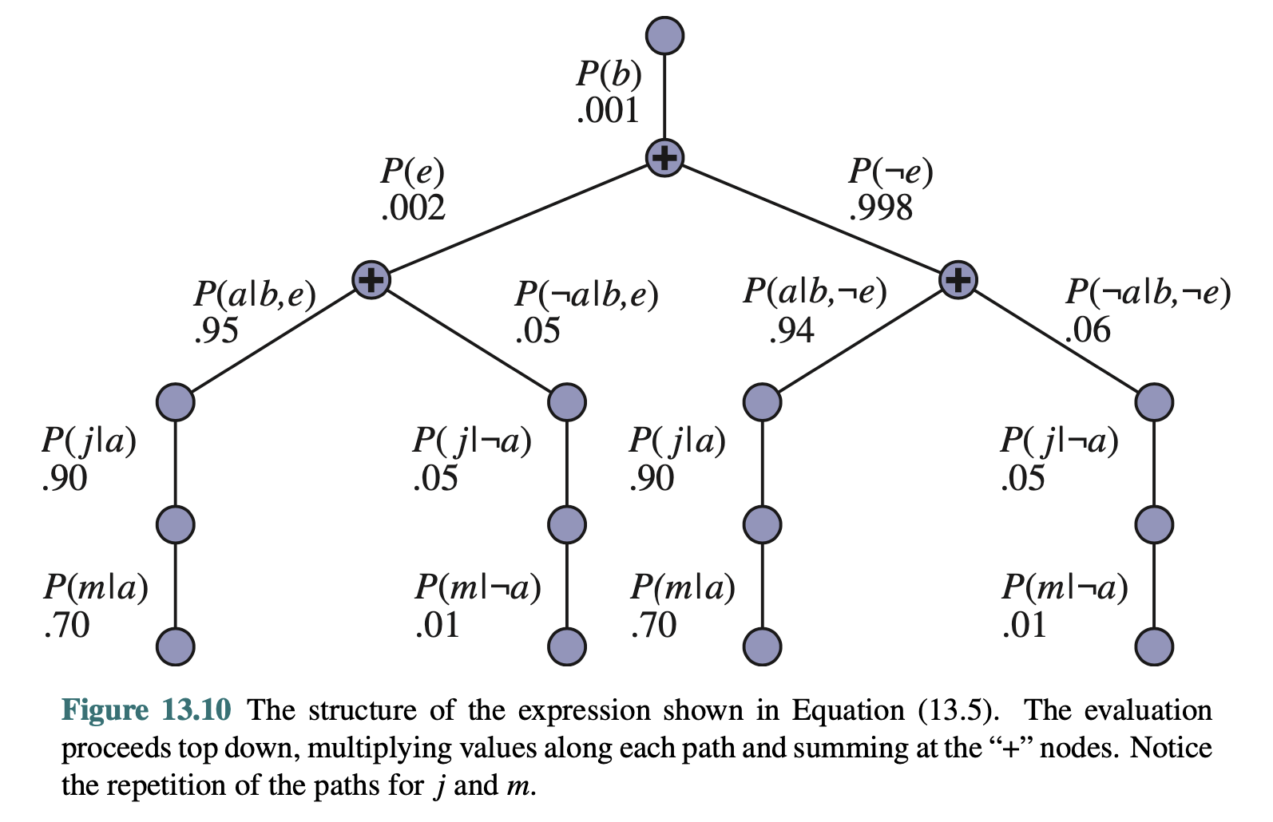
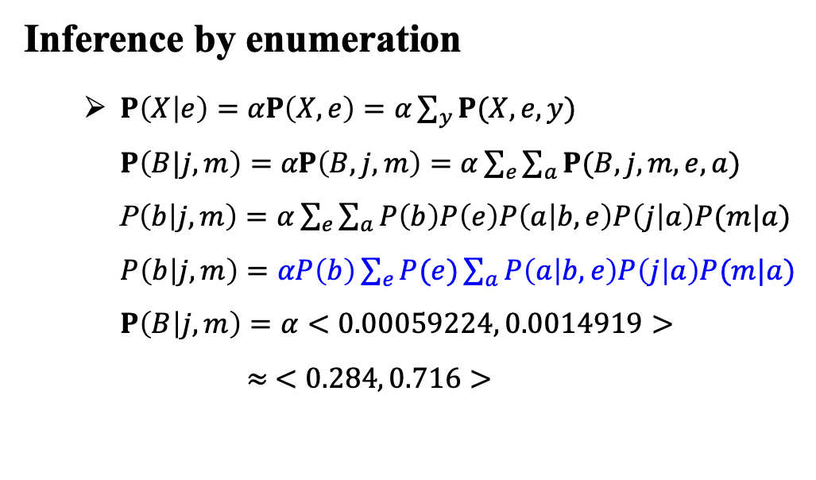
11.3 Exact Inference in Bayesian Networks (2/5)
Inference by enumeration
$P\left(X | e\right)=αP\left(X,e\right)=α\sum_{y}{P(X,e,y)}$ $P\left(B|j,m\right)=αP\left(B,j,m\right)=α\sum_{e}{\sum_{a}{P(B,j,m,e,a)}}$ P$\left(b | j,m\right)=α\sum_{e}{\sum_{a}{P\left(b\right)P\left(e\right)P\left(a | b,e\right)P\left(j | a\right)P(m|a)}}$ $P\left(b | j,m\right)=αP\left(b\right)\sum_{e}{P(e)\sum_{a}{P\left(a | b,e\right)P\left(j | a\right)P(m|a)}}$ $P\left(B | j,m\right)=α<0.00059224, 0.0014919>$ $≈ <0.284, 0.716>$
<출처> Stuart J. Russell and Peter Norvig (2021). Artificial Intelligence: A Modern Approach (4th Edition). Pearson

Slide 20




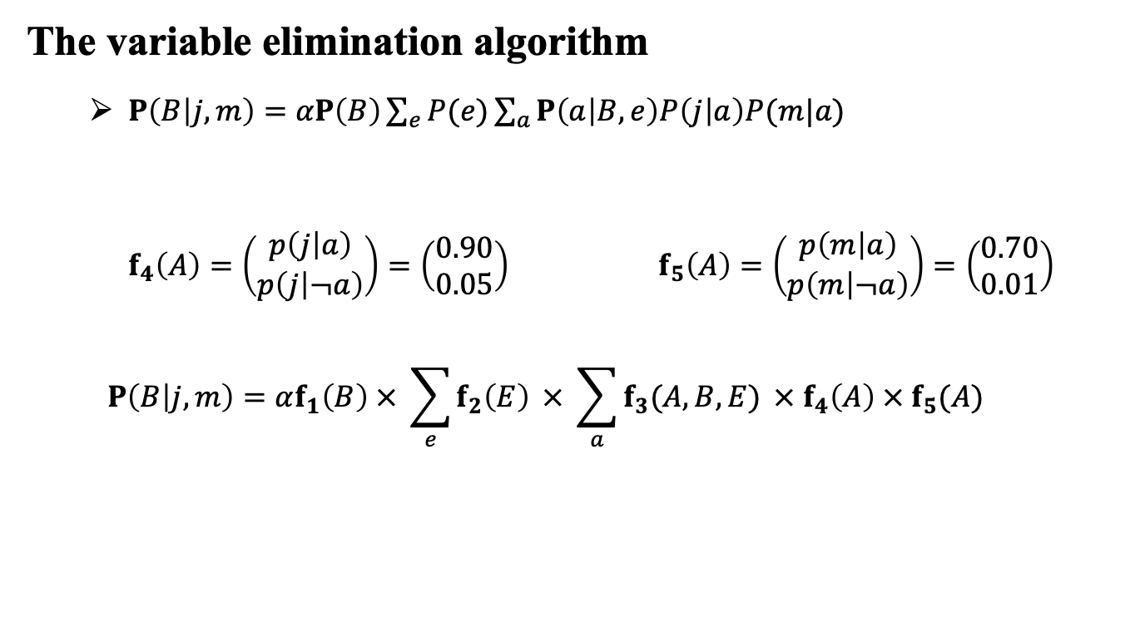

11.3 Exact Inference in Bayesian Networks (3/5)
The variable elimination algorithm
$P\left(B | j,m\right)=αP\left(B\right)\sum_{e}{P(e)\sum_{a}{P\left(a | B,e\right)P\left(j | a\right)P(m|a)}}$
$f_{4}\left(A\right)=\left(\begin{matrix}p\left(j | a\right) \\ p\left(j | ¬a\right)\end{matrix}\right)=\left(\begin{matrix}0.90 \\ 0.05\end{matrix}\right)$ $f_{5}\left(A\right)=\left(\begin{matrix}p\left(m | a\right) \\ p\left(m | ¬a\right)\end{matrix}\right)=\left(\begin{matrix}0.70 \\ 0.01\end{matrix}\right)$
$$P\left(B | j,m\right)=αf_{1}\left(B\right) × \sum_{e}{f_{2}\left(E\right)} × \sum_{a}{f_{3}(A,B,E)} × f_{4}\left(A\right) × f_{5}(A)$$
$$f_{1}(B)$$
$$f_{2}(E)$$
$$f_{3}(A|B,E)$$
$$f_{4}(A)$$
$$f_{5}(A)$$
<출처> Stuart J. Russell and Peter Norvig (2021). Artificial Intelligence: A Modern Approach (4th Edition). Pearson

Slide 21
11.3 Exact Inference in Bayesian Networks (4/5)
Variable ordering and variable relevance
Every choice of ordering yields a valid algorithm.
Different orderings cause different intermediate factors to be generated during the calculation.
In general, the time and space requirements of variable elimination are dominated by the size of the largest factor constructed during the operation of the algorithm.
Determined by the order of elimination of variables and by the structure of the network.

Slide 22
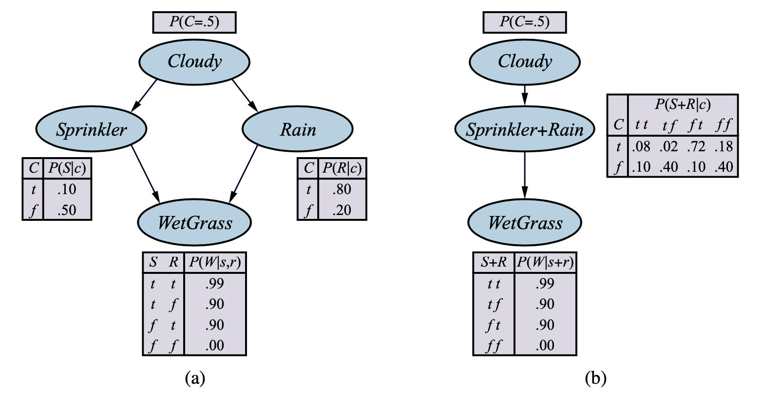
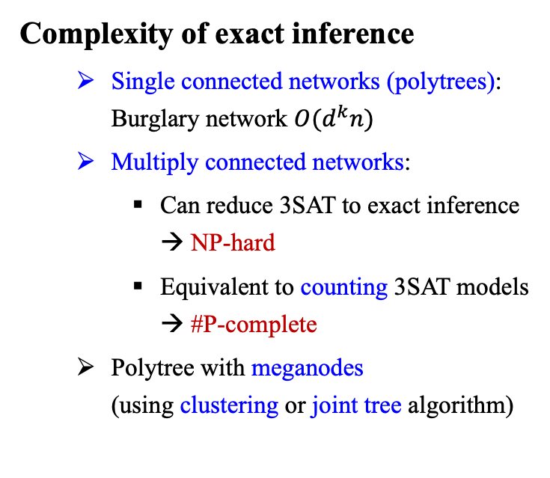
11.3 Exact Inference in Bayesian Networks (5/5)
Complexity of exact inference
Single connected networks (polytrees): Burglary network $O(d^{k}n)$
Multiply connected networks:
Can reduce 3SAT to exact inference → NP-hard
Equivalent to counting 3SAT models → #P-complete
Polytree with meganodes (using clustering or joint tree algorithm)
Multiply connected network
Clustered equivalent (with meganodes)
<출처> Stuart J. Russell and Peter Norvig (2021). Artificial Intelligence: A Modern Approach (4th Edition). Pearson

Slide 23
11.4 Approximate Inference for
Bayesian Networks

Slide 24
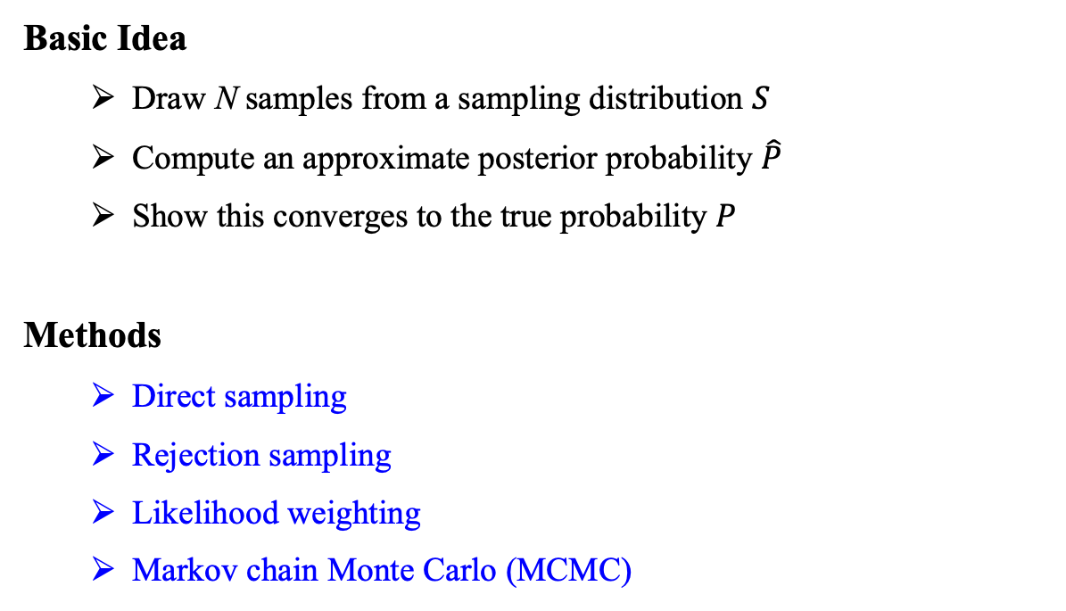
11.4 Approximate Inference for Bayesian Networks (1/10)
Basic Idea
Draw N samples from a sampling distribution $S$
Compute an approximate posterior probability $\hat{P}$
Show this converges to the true probability $P$
Methods
Direct sampling
Rejection sampling
Likelihood weighting
Markov chain Monte Carlo (MCMC)

Slide 25
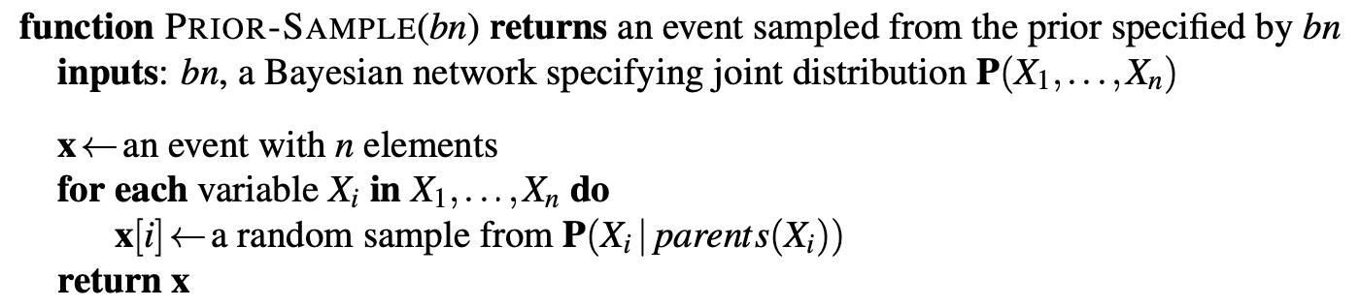
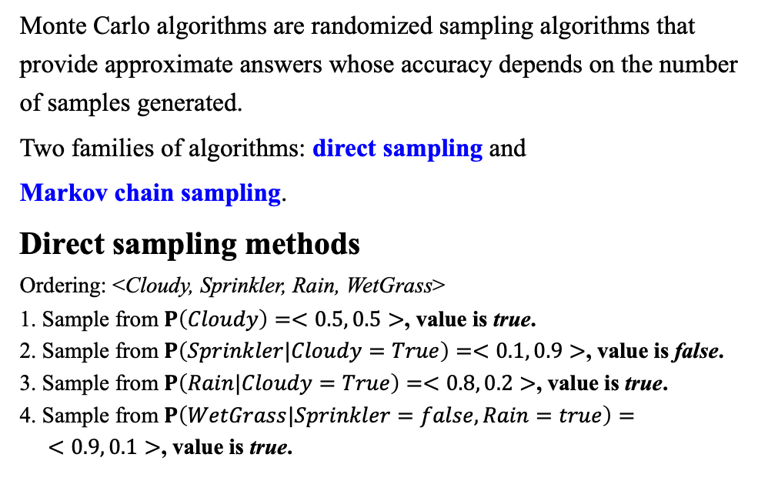
11.4 Approximate Inference for Bayesian Networks (2/10)
Monte Carlo algorithms are randomized sampling algorithms that provide approximate answers whose accuracy depends on the number of samples generated.
Two families of algorithms: direct sampling and
Markov chain sampling.
Direct sampling methods
Ordering: <Cloudy, Sprinkler, Rain, WetGrass>
1. Sample from $P\left(Cloudy\right)=<0.5, 0.5>$, value is true.
2. Sample from $P\left(Sprinkler|Cloudy=True\right)=<0.1, 0.9>$, value is false.
3. Sample from $P\left(Rain|Cloudy=True\right)=<0.8, 0.2>$, value is true.
4. Sample from $P\left(WetGrass|Sprinkler=false,Rain=true\right)=$
$<0.9, 0.1>$, value is true.
<출처> Stuart J. Russell and Peter Norvig (2021). Artificial Intelligence: A Modern Approach (4th Edition). Pearson

Slide 26
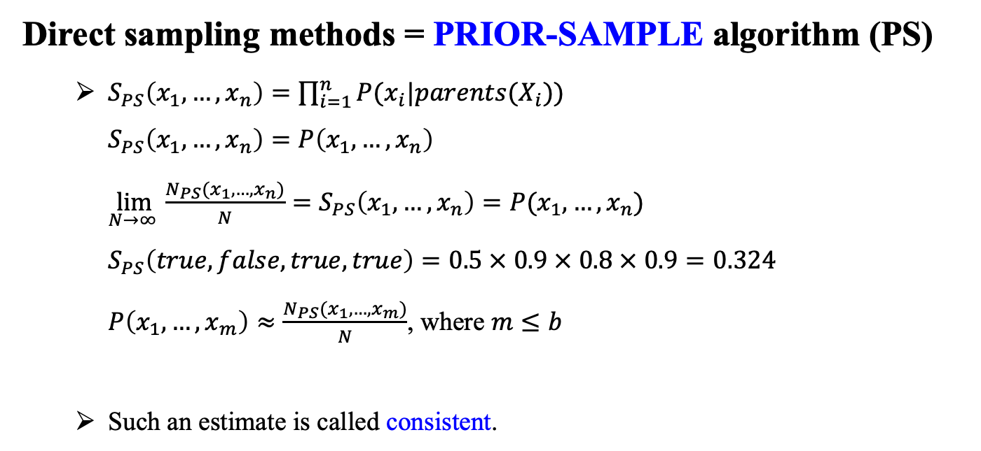
11.4 Approximate Inference for Bayesian Networks (3/10)
Direct sampling methods = PRIOR-SAMPLE algorithm (PS)
$S_{PS}\left(x_{1},…,x_{n}\right)=\prod_{i=1}^{n}{P(x_{i}|parents(X_{i}))}$ $S_{PS}\left(x_{1},…,x_{n}\right)=P\left(x_{1},…,x_{n}\right)$ $\lim_{N→∞ }{\frac{N_{PS}(x_{1},…,x_{n})}{N}=S_{PS}\left(x_{1},…,x_{n}\right)=P(x_{1},…,x_{n})}$ $S_{PS}\left(true,false,true,true\right)=0.5 × 0.9 × 0.8 × 0.9=0.324$ $P\left(x_{1},…,x_{m}\right)≈\frac{N_{PS}(x_{1},…,x_{m})}{N}$, where $m≤b$
Such an estimate is called consistent.

Slide 27
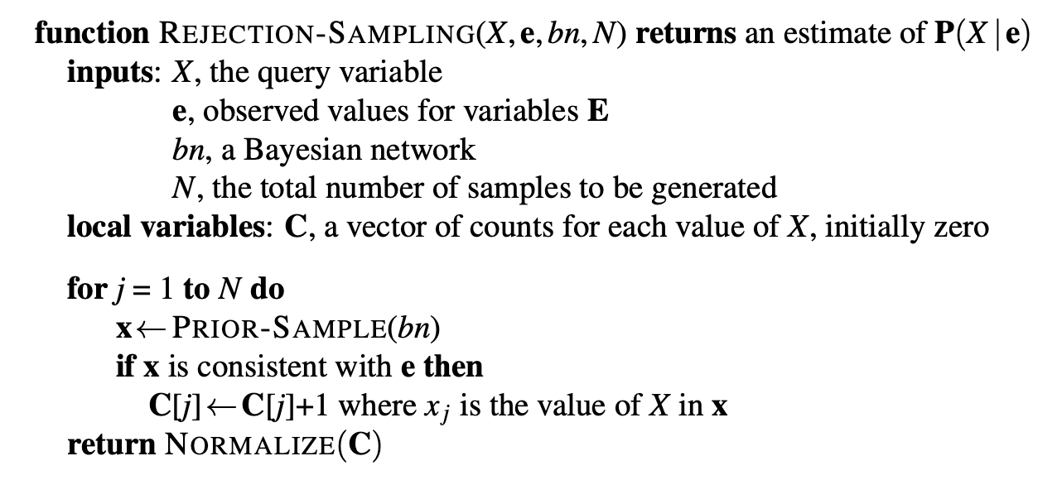
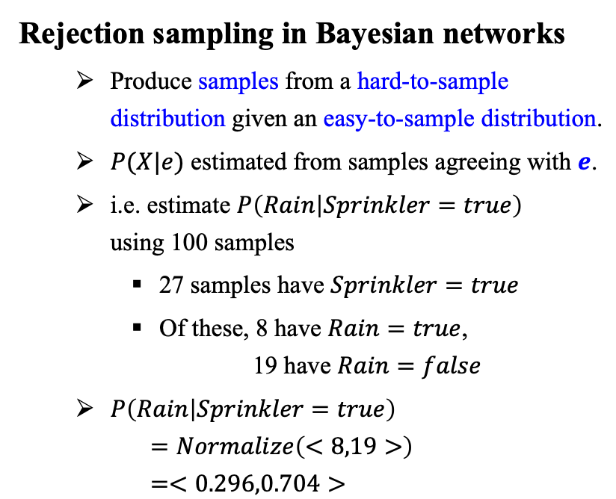
11.4 Approximate Inference for Bayesian Networks (4/10)
Rejection sampling in Bayesian networks
Produce samples from a hard-to-sample distribution given an easy-to-sample distribution.
$P(X|e)$ estimated from samples agreeing with $e\text{.}$
i.e. estimate $P\left(Rain | Sprinkler=true\right)$ using 100 samples
27 samples have $Sprinkler=true$
Of these, 8 have $Rain=true$, 19 have $Rain=false$
$P\left(Rain | Sprinkler=true\right)$ $=Normalize\left(<8,19>\right)$ $=<0.296,0.704>$
<출처> Stuart J. Russell and Peter Norvig (2021). Artificial Intelligence: A Modern Approach (4th Edition). Pearson

Slide 28
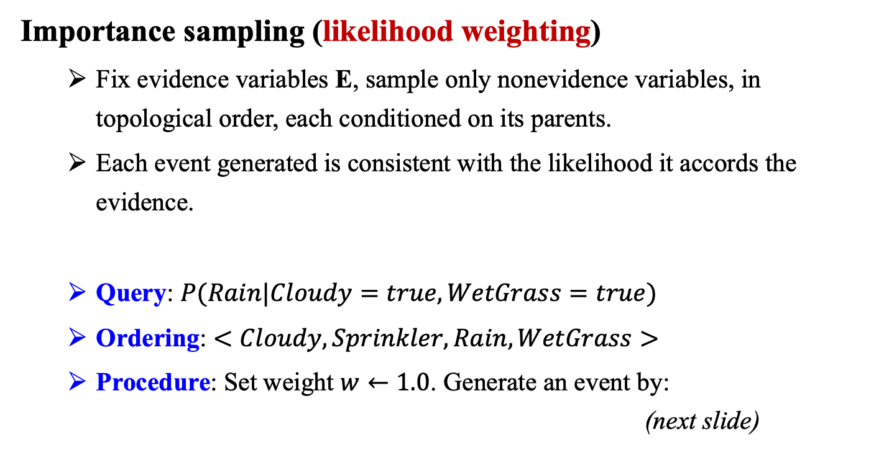
11.4 Approximate Inference for Bayesian Networks (5/10)
Importance sampling (likelihood weighting)
Fix evidence variables E, sample only nonevidence variables, in topological order, each conditioned on its parents.
Each event generated is consistent with the likelihood it accords the evidence.
Query: $P(Rain|Cloudy=true,WetGrass=true)$
Ordering: $<Cloudy,Sprinkler,Rain,WetGrass>$
Procedure: Set weight $w←1.0$. Generate an event by: (next slide)

Slide 29
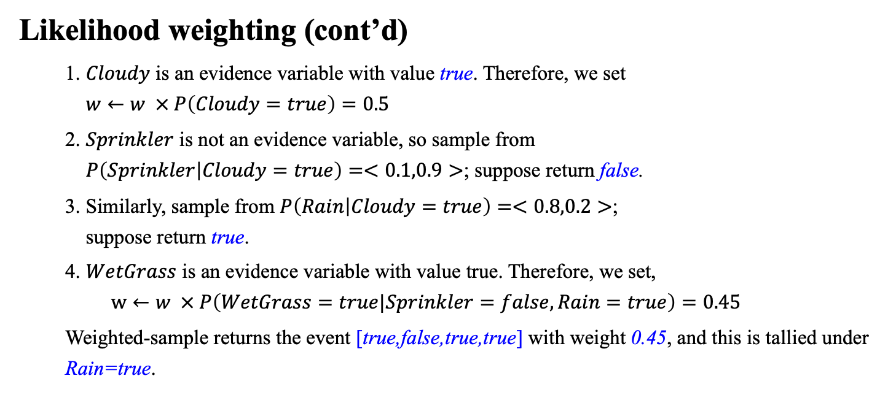
11.4 Approximate Inference for Bayesian Networks (6/10)
Likelihood weighting (cont’d)
1. $Cloudy$ is an evidence variable with value true. Therefore, we set $w←w × P\left(Cloudy=true\right)=0.5$
2. $Sprinkler$ is not an evidence variable, so sample from $P\left(Sprinkler | Cloudy=true\right)=<0.1,0.9>$; suppose return false.
3. Similarly, sample from $P\left(Rain | Cloudy=true\right)=<0.8,0.2>$; suppose return true.
4. $WetGrass$ is an evidence variable with value true. Therefore, we set, $$w←w × P\left(WetGrass=true|Sprinkler=false,Rain=true\right)=0.45$$
Weighted-sample returns the event [true,false,true,true] with weight 0.45, and this is tallied under Rain=true.

Slide 30
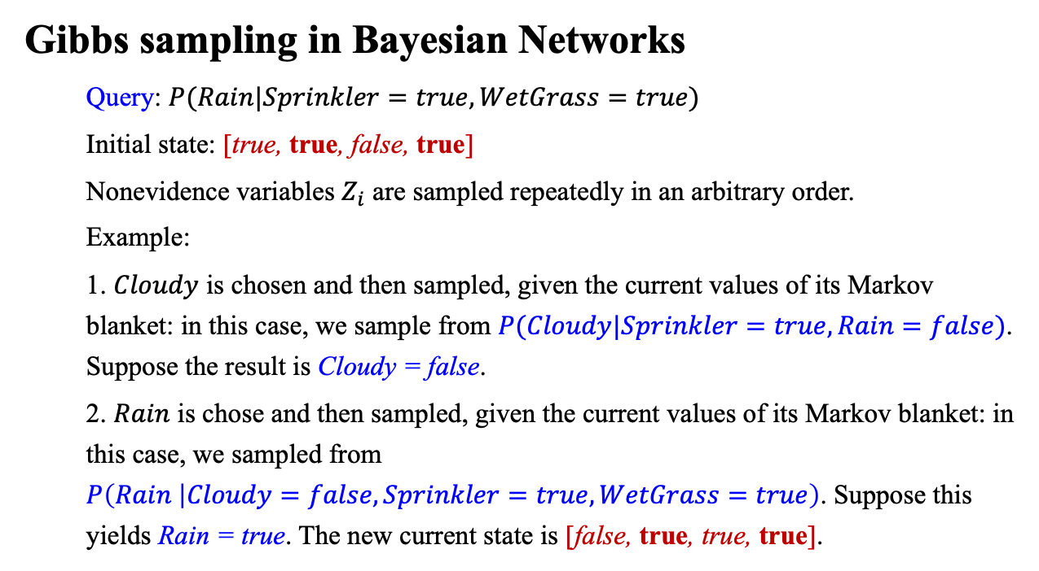
11.4 Approximate Inference for Bayesian Networks (7/10)
Gibbs sampling in Bayesian Networks
Query: $P(Rain|Sprinkler=true,WetGrass=true)$
Initial state: [true, true, false, true]
Nonevidence variables $Z_{i}$ are sampled repeatedly in an arbitrary order.
Example:
1. $Cloudy$ is chosen and then sampled, given the current values of its Markov blanket: in this case, we sample from $P(Cloudy|Sprinkler=true,Rain=false)$. Suppose the result is Cloudy = false.
2. $Rain$ is chose and then sampled, given the current values of its Markov blanket: in this case, we sampled from $P\left(Rain | Cloudy=false,Sprinkler=true,WetGrass=true\right)$. Suppose this yields Rain = true. The new current state is [false, true, true, true].

Slide 31
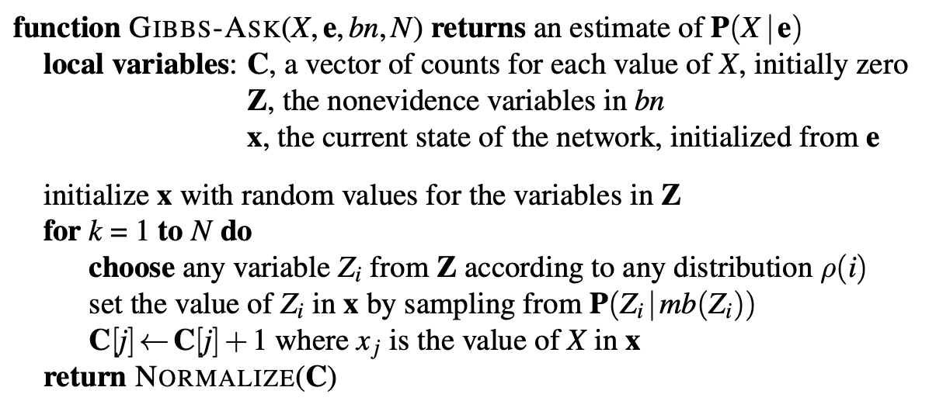
11.4 Approximate Inference for Bayesian Networks (8/10)
Approximate inference using MCMC
State of network = current assignment to all variables.
Generate next state by sampling one variable given Markov blanket.
Sample each variable in turn, keeping evidence fixed.
Can choose a variable to sample at random each time.
<출처> Stuart J. Russell and Peter Norvig (2021). Artificial Intelligence: A Modern Approach (4th Edition). Pearson

Slide 32
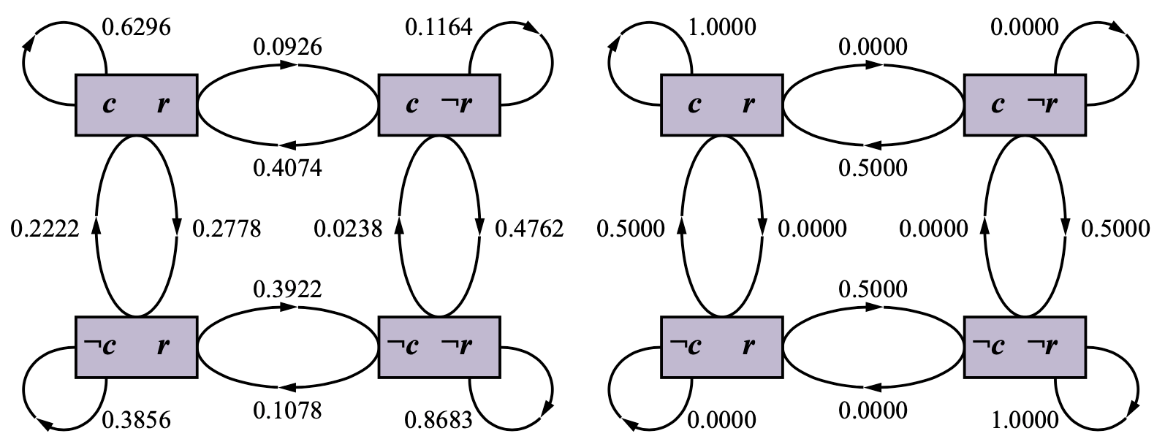
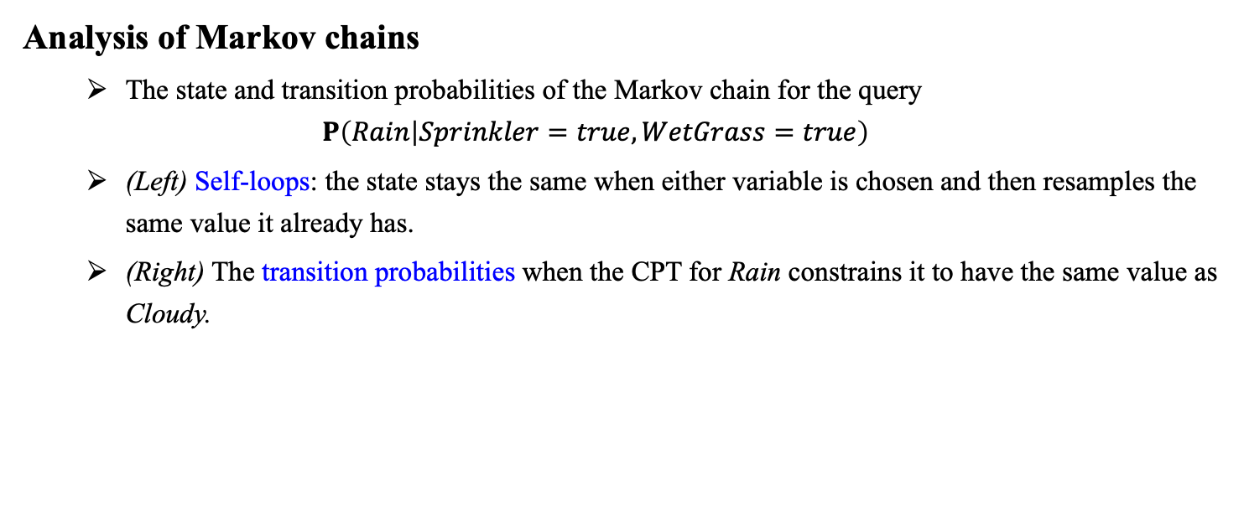
11.4 Approximate Inference for Bayesian Networks (9/10)
Analysis of Markov chains
The state and transition probabilities of the Markov chain for the query $P\left(Rain | Sprinkler=true,WetGrass=true\right)$
(Left) Self-loops: the state stays the same when either variable is chosen and then resamples the same value it already has.
(Right) The transition probabilities when the CPT for Rain constrains it to have the same value as Cloudy.
<출처> Stuart J. Russell and Peter Norvig (2021). Artificial Intelligence: A Modern Approach (4th Edition). Pearson

Slide 33
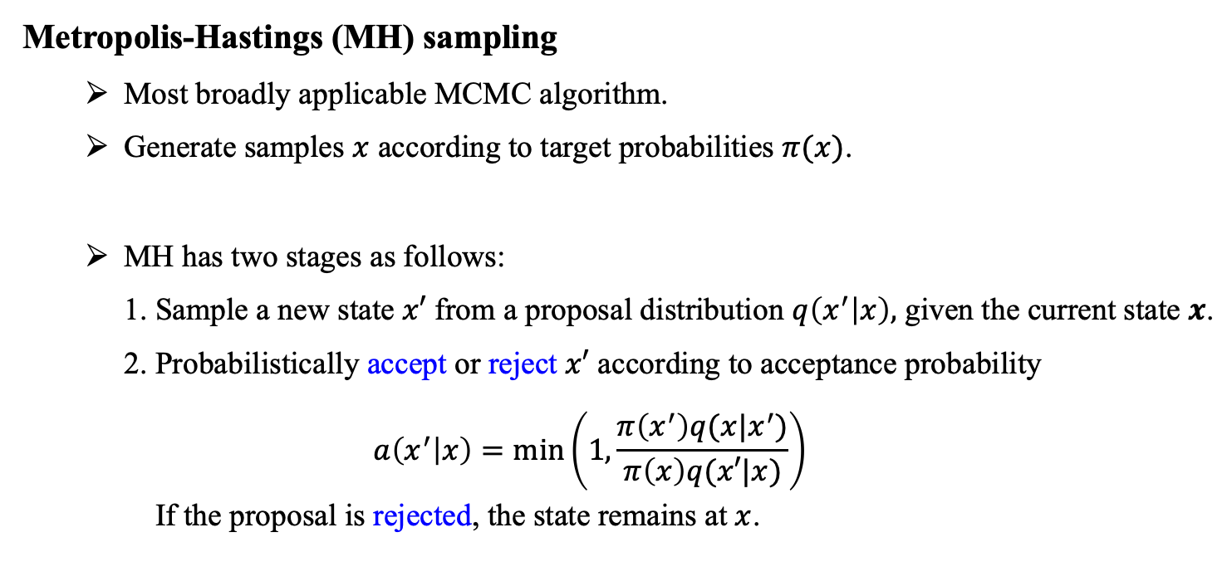
11.4 Approximate Inference for Bayesian Networks (10/10)
Metropolis-Hastings (MH) sampling
Most broadly applicable MCMC algorithm.
Generate samples $x$ according to target probabilities $π(x)$.
MH has two stages as follows:
1. Sample a new state $x′$ from a proposal distribution $q\left(x^{′} | x\right),$ given the current state $x$.
2. Probabilistically accept or reject $x′$ according to acceptance probability $$a\left(x^{′} | x\right)=min\left(1,\frac{π\left(x^{′}\right)q(x|x^{′})}{π\left(x\right)q(x′|x)}\right)$$ If the proposal is rejected, the state remains at $x$.

Slide 34
Summary
A Bayesian network is a directed acyclic graph whose nodes correspond to random variables; each node has a conditional distribution for the node, given its parents
Bayesian network provide a way to represent conditional independence relationship and specifies a joint probability distribution over its variable.
Inference in Bayesian networks means computing the probability distribution of a set of query variables, given a set of evidence variables. Exact inference algorithms, such as variable elimination, evaluate sum of products of conditional probabilities as efficiently as possible.
In polytrees, exact inference takes time linear in the size of the network.
Random sampling techniques such as likelihood weighting and Markov chain Monte Carlo can give reasonable estimates of the true posterior probabilities in a network.
Whereas Bayes nets capture probabilistic influences, causal networks capture causal relationships and allow prediction of the effects of interventions as well as observations.

